Slide 1
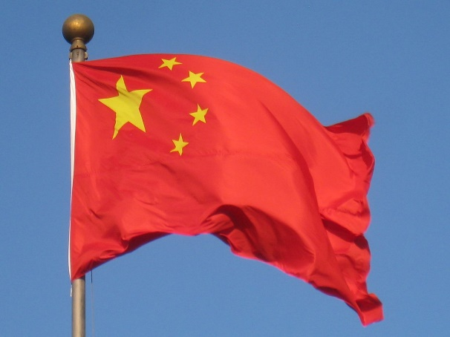
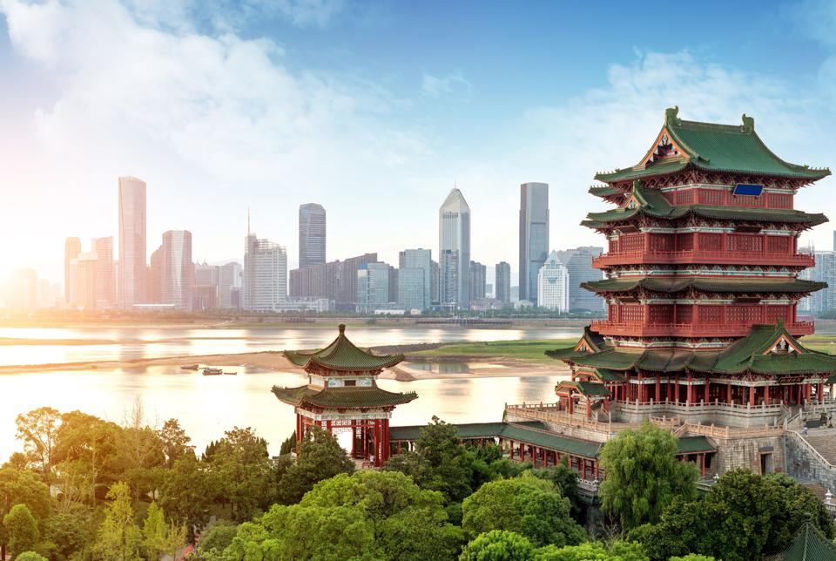
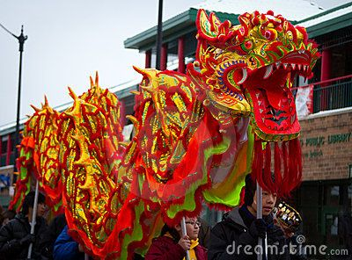
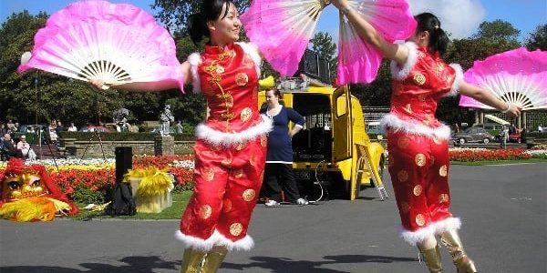
The Chinese New year is a 15 day celebration which starts on the New Moon towards the end of every January.

Slide 2
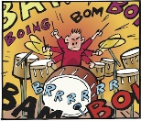
The story of the Chinese New year comes from a legend a long long time ago.
The legend says that a Monster called ‘Nian’ would come out on every new Moon and scare everyone. However a wise old man told the people of China that Nian was scared of 3 things; Fire, loud noises and the colour Red. So, on the next new moon the people of China banged their drums, let off fire crackers, wore red clothes and made fires and Nian ran away and was never ever seen again!!
So now the people in China celebrate the New Year with friends and family by eating delicious food, decorating their houses, giving each other red envelopes and gifts, dancing and wearing the colour red.

Slide 3
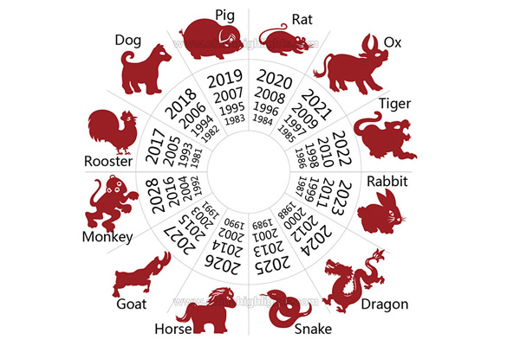
The Emperor also told all the animals in the land that f they had a race the winner would have a year named after it.
So all the animals raced across the land to the Emperors palace and even though the Ox was winning, once he got to the river the cheeky Rat jumped on his back and reached the palace first!
However, the Emperor gave all the animals a year for them to be named after but the Rat is the first and the Ox the second in the order of the calendar.

Slide 4
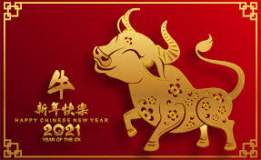
This year in 2020, it is the year of the Ox (Cow). In the Chinese Horoscope there are 12 different Animals.
Each animal represents something different and depending on which year you were born will depend on which animal you are. Can you work out from the chart which one you are?!

Slide 5
Animal quiz;
1 This animal eats almost anything?
2. Can you name a film with a ‘Dog’ in it?
3. The Chinese version of this animal does NOT have wings, which animal is it?
4. These animals can be very noisy when the sun is rising?
5. This animal is late in a very famous film?
6. This animal can make us warm jumpers?
7. A film named after a vegetarian meal stars this animal?
8. This animal is in a book and came to Tea?!
9. This animal is in the jungle book and begins with the letter ‘K’
10. This animal was in a famous film/theatre production about the first world war.
11. There is a tree named after this animal.
12. This animal is very large and has 4 stomachs!!

Slide 6
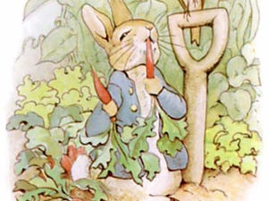
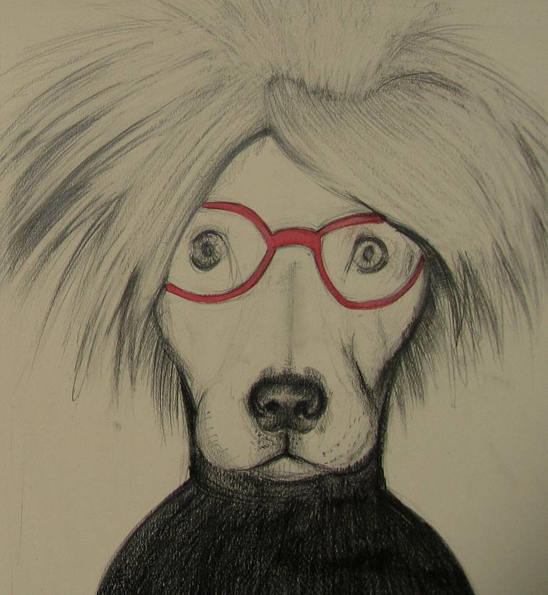
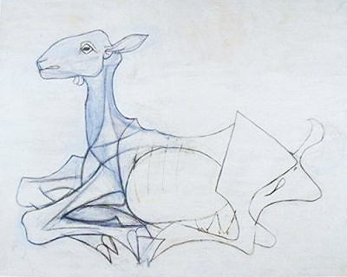
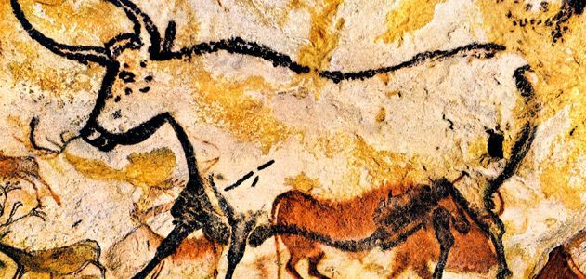
Lots of artists draw or paint animals. Can you draw one of the animals from the Chinese horoscope. You can use; pencil, pens, paint, collage materials etc and make them as individual as you like. It could wear a hat, be decorative, be colourful or just a bold shape and remember it does not have to be perfect!

